Slide 1

SCSA1402-COMPUTER ARCHITECTURE AND ORGANIZATION
Dr. S. Emalda Roslin, M.E., Ph.D.,
Professor,
Department of ECE,
Sathyabama Institute of Science and Technology,
Chennai

Slide 2
C= A +B
High level language
Macro Level
Get input from the input device
Store it somewhere (Memory or register)
Operation should be performed (Arithmetic or logic operations- correct operation should be selected)
On the operands, the operation should be performed
After performing operation, result should be stored somewhere
This somewhere will be answered by COMPUTER ARCHITECTURE
After getting the input, A value will be stored in one among the many registers
Selection unit is responsible for selecting the register (Decoder or Multiplexer is used)
After getting the input, B value will be stored in one among the many registers
From the registers, using wires or data bus data will be transferred to the ALU for performing arithmetic operations
Again the result will be stored in any one of the registers
Easy to explain in English, but machine will not understand
A Control word, used for performing all these operations. By writing a set of sequences called a control word, we could make the machine perform any operation that we require
From Macro leve C=A+B, understanding it in micro level is dealt in computer architecture

Slide 3
COURSE OUTCOMES
CO1 - Classify the various types of registers, microinstructions
and addressing modes.
CO2 - Design the data path for processor.
CO3 - Demonstrate the usage of Memory Organization.
CO4 - Describe about the I/O devices.
CO5 - Explain the characteristics, structure, communication and
synchronization of multiprocessor.
CO6 - State the inter processor communication and
synchronization.

Slide 4

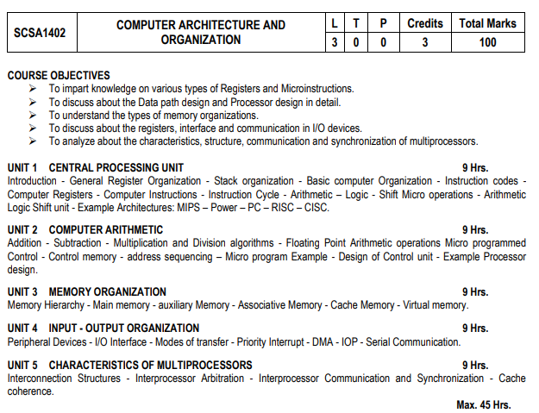

Slide 5
TEXT / REFERENCE BOOKS
1. M.Morris Mano, “Computer system Architecture”, 3rd Edition, Prentice-Hall
Publishers, 2007.
2. Mark Burrell, “Fundamentals of Computer Architecture”, Mcmillan Higher Education,
2003.
3. John D. Carpinelli, “Computer Systems Organization and Architecture”, Pearson
Education, 2001.
4. Carl Hamacher, Zvonko Vranesic and Safwat Zaky, “Computer Organization”, 5 th
Edition, McGraw-Hill, 2002.
5. William Stallings, “Computer Organization and Architecture - Designing for
Performance”, 9 th Edition, Prentice Hall, 2012.
6. John P Hayes, Computer Architecture Organization, McGraw Hill Edition 4, 2003.

Slide 6
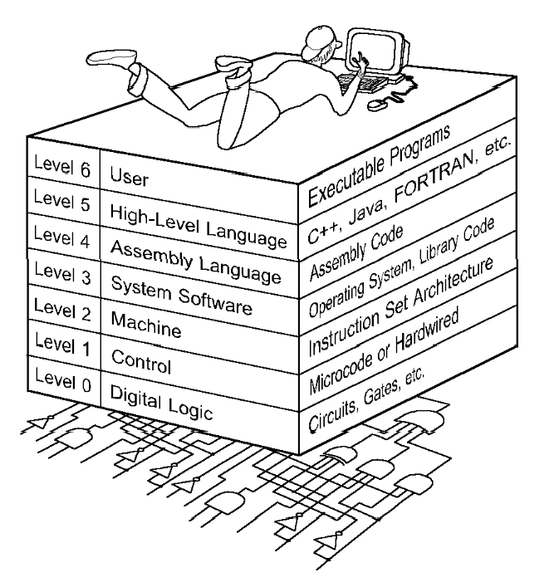
COMPUTER LEVEL HIERARCHY
Binary or Machine Language - 010110
Assembly Language - MOV A,B
High Level Language – C,C++,etc.

Slide 7
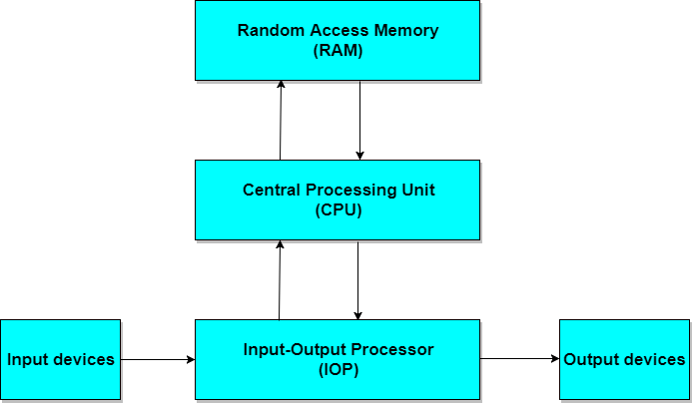
BLOCK DIAGRAM OF DIGITAL COMPUTER

Slide 8
COMPUTER ARCHITECTURE
Computer architecture is a specification detailing how a set of software and hardware technology standards interact to form a computer system or platform.
In short, computer architecture refers to how a computer system is designed and what technologies it is compatible with.
As with other contexts and meanings of the word architecture, computer architecture is likened to the art of determining the needs of the user/system/technology, and creating a logical design and standards based on those requirements.
A very good example of computer architecture is von Neumann architecture, which is still used by most types of computers today.
This was proposed by the mathematician John von Neumann in 1945.
It describes the design of an electronic computer with its CPU, which includes the arithmetic logic unit, control unit, registers, memory for data and instructions, an input/output interface and external storage functions.

Slide 9
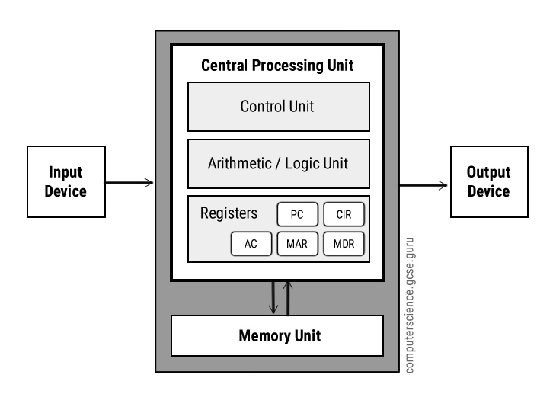
THE VON NEUMANN MODEL
Central Processing Unit (CPU)
The Central Processing Unit (CPU) is the electronic circuit responsible for executing the instructions of a computer program.
It is sometimes referred to as the microprocessor or processor.
Registers
Registers are high speed storage areas in the CPU. All data must be stored in a register before it can be processed.
MAR | Memory Address Register | Holds the memory location of data that needs to be accessed
MDR | Memory Data Register | Holds data that is being transferred to or from memory
AC | Accumulator | Where intermediate arithmetic and logic results are stored
PC | Program Counter | Contains the address of the next instruction to be executed
CIR | Current Instruction Register | Contains the current instruction during processing
Arithmetic and Logic Unit (ALU)
The ALU allows arithmetic (add, subtract etc) and logic (AND, OR, NOT etc) operations to be carried out.

Slide 10
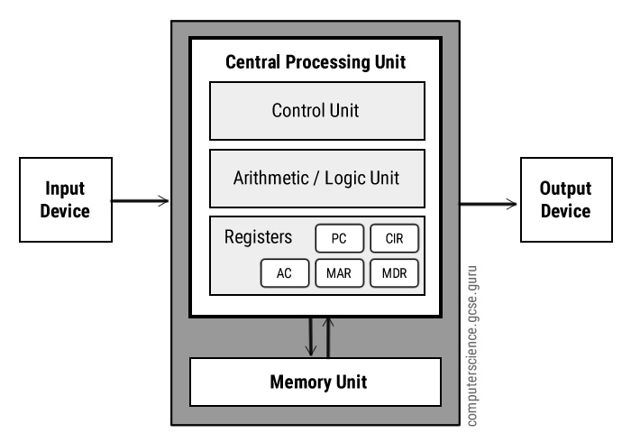
THE VON NEUMANN MODEL Contd.
Control Unit (CU)
The control unit controls the operation of the computer’s ALU, memory and input/output devices, telling them how to respond to the program instructions it has just read and interpreted from the memory unit.
The control unit also provides the timing and control signals required by other computer components.
Buses
Buses are the means by which data is transmitted from one part of a computer to another, connecting all major internal components to the CPU and memory.
A standard CPU system bus is comprised of a control bus, data bus and address bus.
Address Bus | Carries the addresses of data (but not the data) between the processor and memory
Data Bus | Carries data between the processor, the memory unit and the input/output devices
Control Bus | Carries control signals/commands from the CPU (and status signals from other devices) in order to control and coordinate all the activities within the computer
Memory Unit
The memory unit consists of RAM, sometimes referred to as primary or main memory. Unlike a hard drive (secondary memory), this memory is fast and also directly accessible by the CPU.

Slide 11

FUNCTIONAL AND STRUCTURAL UNITS OF A COMPUTER
There are four main functions of a computer:
Data processing
Data storage
Data movement
Control
Main Structural Blocks/Parts:
Central Processing Unit (CPU): Controls the operation of the computer and performs its data processing functions. Often simply referred to as processor.
Main Memory: Stores data.
I/O: Moves data between the computer and its external environment.
System Interconnection: e.g. BUS for communication among CPU, main memory, and I/O.

Slide 12
MAJOR STRUCTURAL COMPONENTS OF A CPU
Control Unit (CU): Controls the operation of the CPU and hence the computer.
Arithmetic and Logic Unit (ALU): Performs computer’s data processing functions.
Register: Provides storage internal to the CPU.
CPU Interconnection: communication among the control unit, ALU, and register.

Slide 13
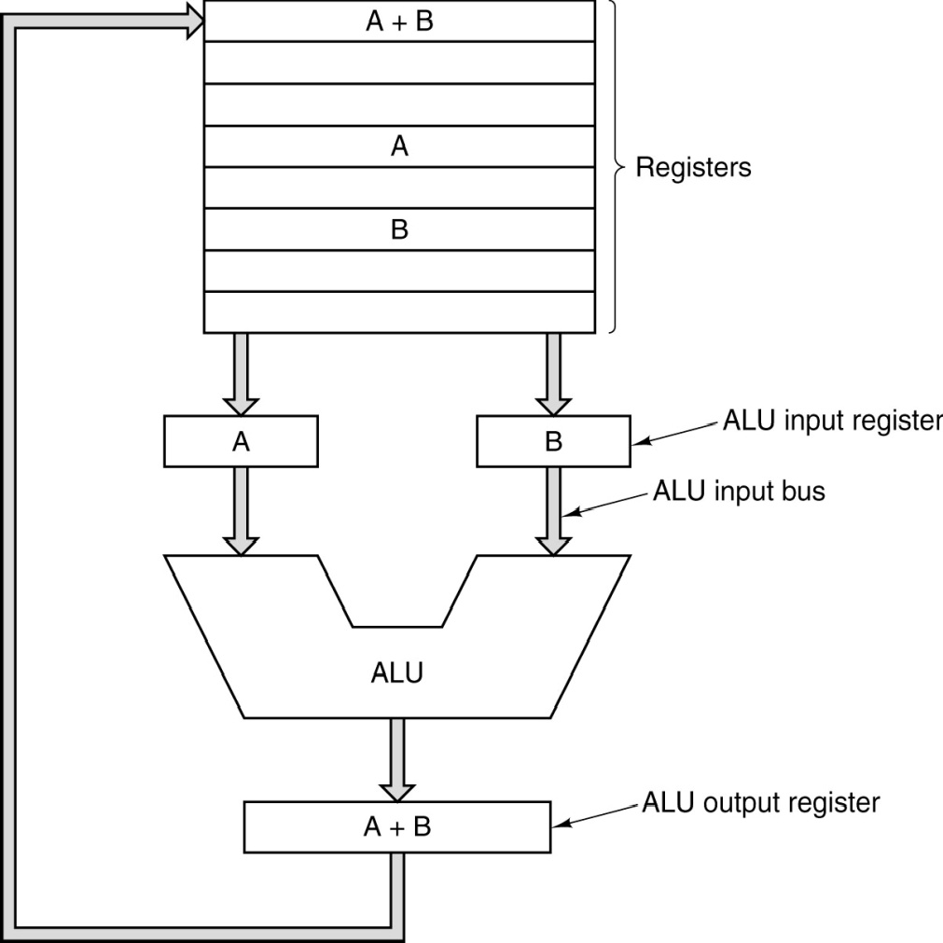
CPU ORGANIZATION
The data path of a typical Von Neumann machine.

Slide 14
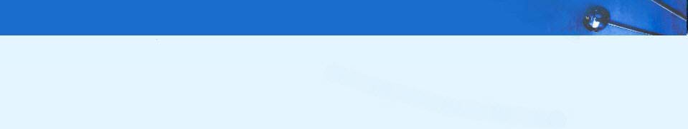
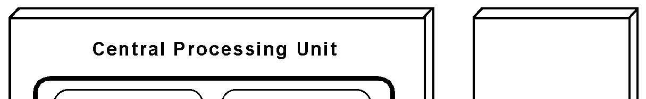
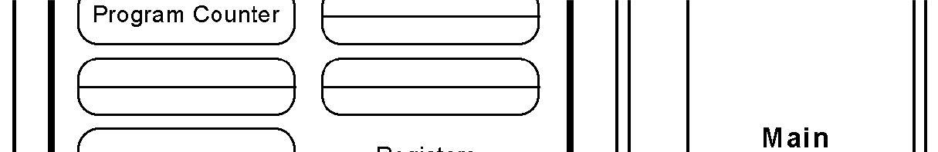
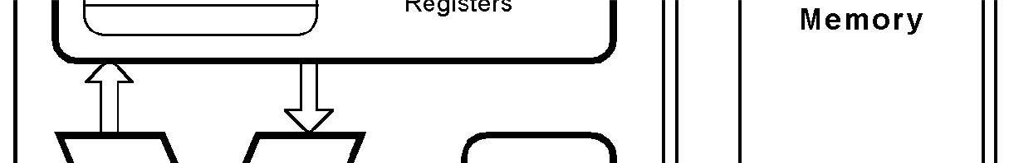
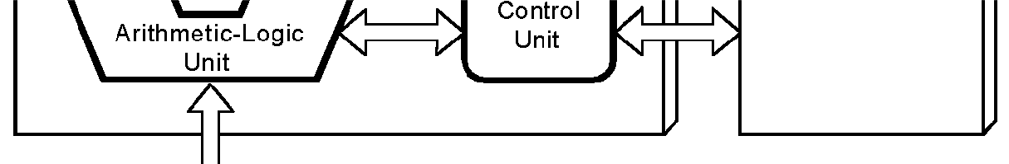
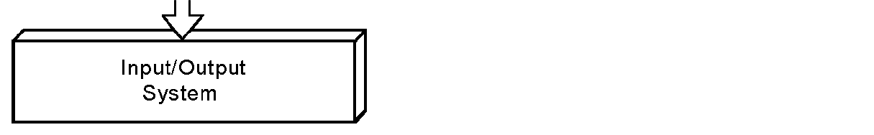
THE VON NEUMANN MODEL
This is a general depiction of a von Neumann system:
These computers employ a fetch- decode-execute cycle to run programs as follows . . .

Slide 15
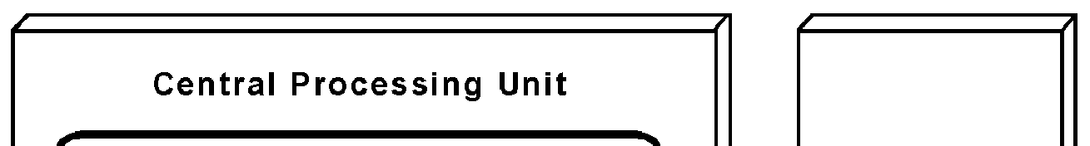
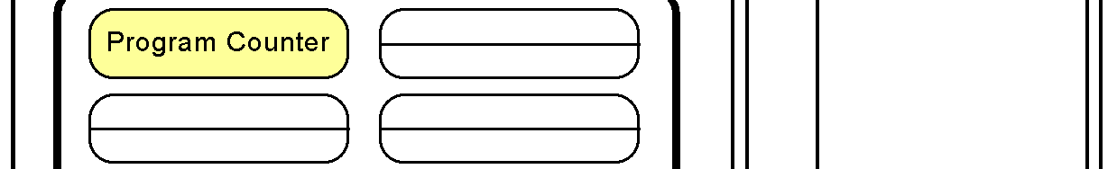

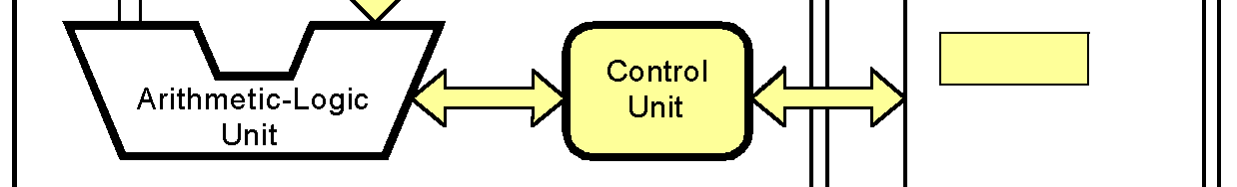
THE VON NEUMANN MODEL Contd.
The control unit fetches the next instruction from memory using the program counter to determine where the instruction is located.

Slide 16
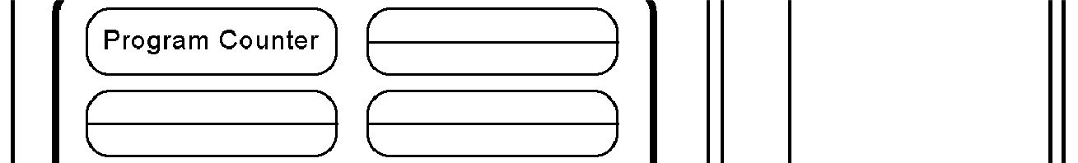

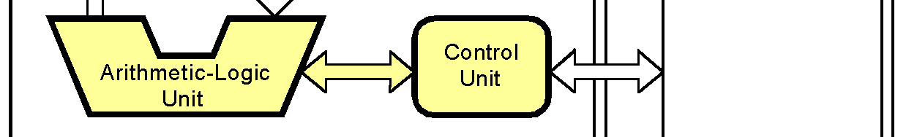
THE VON NEUMANN MODEL Contd.
The instruction is decoded into a language that the ALU can understand.

Slide 17
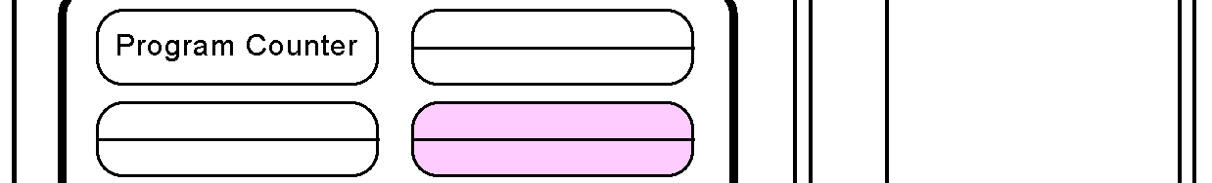
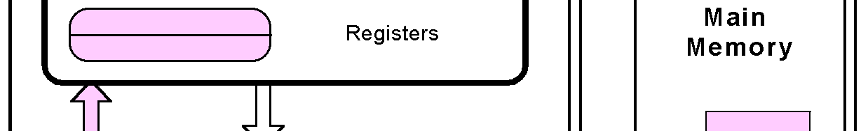
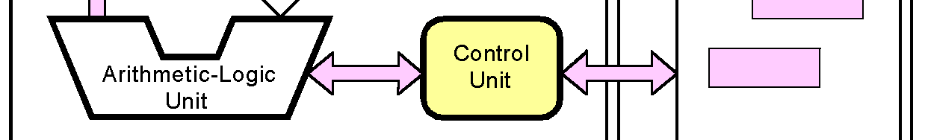
THE VON NEUMANN MODEL Contd.
Any data operands required to execute the instruction are fetched from memory and placed into registers within the CPU.

Slide 18

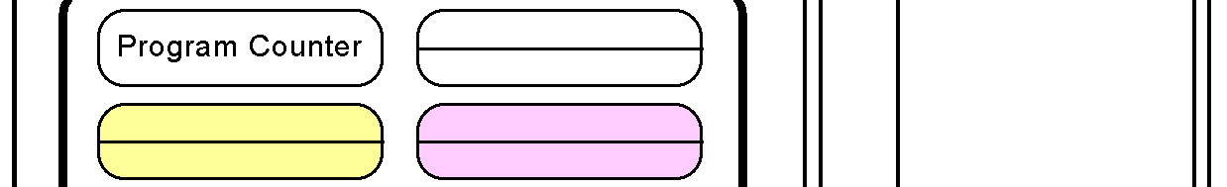
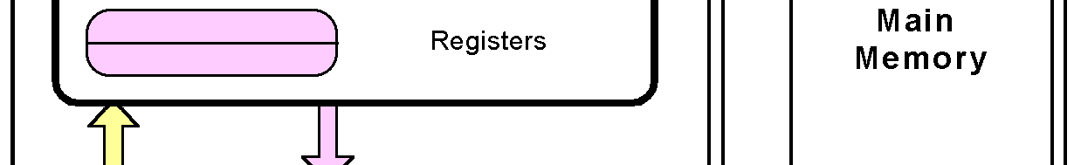
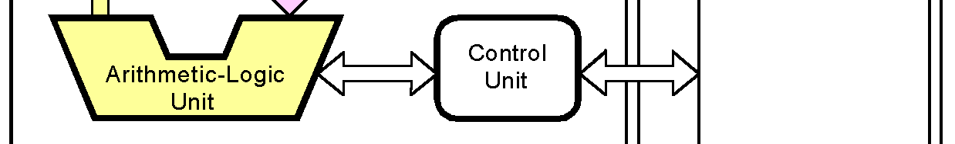
THE VON NEUMANN MODEL Contd.
The ALU executes the instruction and places results in registers or memory.

Slide 19

Central Processing Unit (CPU)

Slide 20
CENTRAL PROCESSING UNIT (CPU)
Introduction
General Register Organization
Stack Organization
Reverse Polish Notation (RPN)

Slide 21
MAJOR COMPONENTS OF CPU
CPU:
Central Processing Unit(CPU) is the part of the computer that performs bulk data processing operation
Components:
ALU
Registers
Control Unit
Register set
Control Unit (CU)
Arithmetic Logic Unit
(
ALU
Arithmetic Logic Unit (ALU):
Performs the required micro operations for executing the instructions
Arithmetic calculations,
Logical computations,
Shifts/Rotates
Registers:
Stores intermediate date used during the execution of instructions
Control Unit :
Supervises the transfer of information among registers and instructs the ALU as to which operation to perform

Slide 22
GENERAL REGISTER ORGANIZATION
Memory is needed for storing
Pointers
Return address
Temporary results
Partial products during Multiplication
Disadvantage of memory
Memory access is the most time consuming operation in a computer
Register organization
The more convenient and efficient way to store these intermediate values is using registers
The register communicate with each other not only for direct data transfer, but also while performing Microoperations

Slide 23
GENERAL REGISTER ORGANIZATIONS
Clock
Input
R1
R2
R3
R4
R5
R6
R7
Load
(7 lines)
{
MUX
MUX
}
SELA
SELB
3 x 8
A bus
B bus
decoder
SELD
ALU
OPR
Output

Slide 24
GENERAL REGISTER ORGANIZATIONS Contd.
A bus organization for seven CPU registers is shown
The output of each register is connected to two multiplexers (MUX) to form the two buses A and B .
The selection lines in each multiplexer select one register or the input data for the particular bus.
The A and B buses form the inputs to acommon arithmetic logic unit (ALU).
The operation selected in the ALU determines the arithmetic or logic micro operation that is to be performed.
The result of the micro operation is available for output data and also goes into the inputs
of all the registers.
The register that receives the information from the output bus is selected by a decoder.
The decoder activates one of the register load inputs, thus providing a transfer path between the data in the output bus and the inputs of the selected destination register.

Slide 25
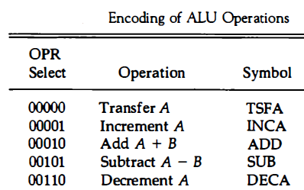
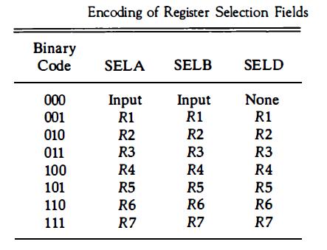
GENERAL REGISTER ORGANIZATIONS Contd.
R1 ←R2 + R3
Clock
Input
R1
R2
R2
R3
R3
R4
R5
R6
R7
Load
(7 lines)
{
MUX
MUX
}
SELA
SELB
010
011
3 x 8
A bus
B bus
decoder
001
SELD
ALU
OPR
00010
Output

Slide 26
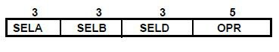
CONTROL WORD
There are 14 binary selection inputs in the unit, and their combined value specifies a control word.
It consists of four fields.
Three fields contain three bits each, and one field has five bits.
The three bits of SELA select a source register for the A input of the
ALU.
The three bits of SELB select a register for the B input of the ALU.
The three bits of SELD select a destination register using the decoder and its seven load outputs.
The five bits of OPR select one of the operations in the ALU.
The 14-bit control word when applied to the selection inputs specify a particular micro operation.
For R1 ←R2 + R3, The Control word is
010 | 011 | 001 | 00010

Slide 27
CONTROL WORD Contd.
R1 ⁼ R2 - R3
Clock
Input
R1
R2
R2
R3
R3
R4
R5
R6
R7
Load
(7 lines)
{
MUX
MUX
}
SELA
SELB
010
011
3 x 8
A bus
B bus
decoder
001
SELD
ALU
OPR
00101
Output
Control word: 010 011 001 00101

Slide 28
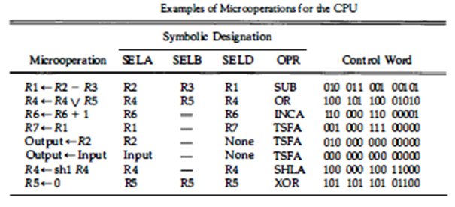
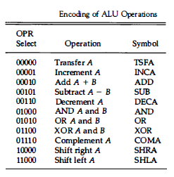
CONTROL WORD Contd.

Slide 29
STACK ORGANIZATION
A useful feature that is included in the CPU of most computers is a stack or last-in, first-out (LIFO) list.
A stack is a storage device that stores information in such a manner that the item stored last is the first item retrieved.
The operation of a stack can be compared to a stack of trays. The last tray placed on top of the stack is the first to be taken off.
The stack in digital computers is essentially a memory unit. The register that holds the address for the stack is called a stack pointer (SP) because its value always points at the top item in the stack.
The two operations of a stack are the insertion and deletion of items.
The operation of insertion is called push. The operation of deletion is called Pop.

Slide 30
STACK ORGANIZATION Contd.
Types:
Register Stack: A stand alone unit that consists of collection of finite number of registers / A stack can be placed in a portion of a large memory or it can be organized as a collection of a finite number of memory words or registers
Memory stack: This Stack can be implemented in RAM memory attached to CPU. Only by assigning special part of it for stack operations

Slide 31
REGISTER STACK ORGANIZATION
In a 64- word stack, the stack pointer contains 6 bits (2⁶ = 64).
Since SP has only six bits, it cannot exceed a number greater than 63 (111111 in binary).
The one-bit register FULL is set to 1 when the stack is full
EMPTY register is 1 when the stack is empty.
The data register DR holds the data to be written into or read from the stack.
Initially, SP is cleared to 0, EMTY is set to 1, and FULL is cleared to 0, so that SP points to the word at address 0 and the stack is marked empty and not full.
If the stack is not full (if FULL = 0), a new item is inserted with a push operation.
stack
Address
Flags
63
FULL
EMPTY
Full=0
Empty=1
SP=000010
4
SP=000001
3
SP=000000
Data 2
2
Data 1
1
SP
0
Stack pointer
DR
DATA 1
PUSH
DATA 2

Slide 32
REGISTER STACK ORGANIZATION Contd.
Full =0
Empty=1
Since SP has only six bits, it cannot exceed a number greater than 63 (111111 in binary).
When 63 is incremented by 1, the result is 0 since 111111 + 1 = 1000000 in binary.
SP can accommodate only the six least significant bits
Full =1
Empty=0
stack
Address
SP=111111
63
4
The push operation is implemented with the following sequence of Micro operations;
C
3
B
2
A
1
DATA
0
SP <- SP + 1 //Increment stack pointer
M [SP] <- DR //Write item on top of the stack
If (SP = 0) then (FULL <--1) //Check if stack is full
EMTY <--0 //Mark the stack not empty
M[SP] denotes the memory word specified by the address presently available in SP
DR
DATA
PUSH

Slide 33
REGISTER STACK ORGANIZATION Contd.
A new item is deleted from the stack if the stack is not empty (if EMTY = 0).
The pop operation consists of the following sequence of micro operations:
stack
Address
Flags
63
FULL
EMPTY
Stack pointer
4
SP
C
3
B
2
A
1
0
DR <--M [SP] //Read item from the top of stack
SP <--SP – 1 //Decrement stack pointer
If (SP = 0) then (EMTY <--1) //Check if stack is empty
FULL <--0 //Mark the stack not full
DR

Slide 34
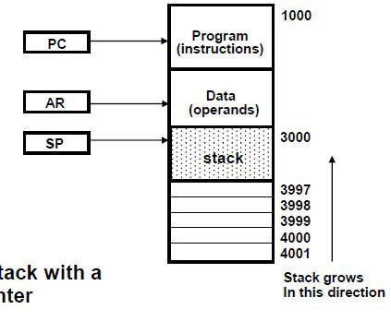
MEMORY STACK ORGANIZATION Contd.
The implementation of a stack in the CPU is done by assigning a portion of memory to a stack operation and using a processor register as a stack pointer.
A portion of computer memory partitioned into three segments: program, data, and stack.
Program Counter(PC) points to next instruction to be executed.
Address Register(AR) points to array of data of operands.
Stack Pointer (SP) points to top of stack.
New item is inserted with Push operation,
then SP is decremented.
SP ← SP-1
M [SP] ← DR
SP is incremented, then Last item is removed
with Pop operation,
DR ← M [SP]
SP ← SP +1
As shown in figure initial value of SP is 4001 and first item when pushed in

Slide 35
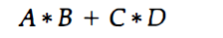
REVERSE POLISH NOTATION (RPN)
A stack organization is very effective for evaluating arithmetic expressions
The common arithmetic expressions are written in infix notation, with each operator written between the operands.
Consider the simple arithmetic expression
To evaluate this arithmetic expression it is necessary to compute the product A • B, store this product while computing C • D, and then sum the two products
To evaluate arithmetic expressions in infix notation it is necessary to scan back and forth along the expression to determine the next operation to be performed.
The Polish mathematician Lukasiewicz showed that arithmetic expressions can be represented in prefix notation . This representation, often referred to as Polish notation, places the operator before the operands. The postfix notation, referred to as reverse Polish notation (RPN), places the operator after the operands.

Slide 36
REVERSE POLISH NOTATION (RPN)
Contd.
The 3 notations to evaluate expressions
1. A + B Infix notation
2. +AB Prefix notation (Polish notation)
3. AB+ Postfix notation (Reverse Polish Notation)
Expression A*B + C*D is written in RPN as AB*CD*+. And will computed as
(A*B) CD *+
(A*B)(C*D)+
Scan the expression from left to right.
When an operator is reached, perform the operation with the two operands found on the left side of the operator.
Remove the two operands and the operator and replace them by the number obtained from the result of the operation.
Continue to scan the expression and repeat the procedure for every operator encountered until there are no more operators.

Slide 37
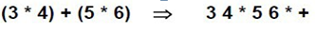
REVERSE POLISH NOTATION (RPN)
Contd.
Reverse polish notation combined with stack comprised of registers is most efficient way to evaluate expression.
Stacks are good for handling long and complex problems involving chain calculations.
But need first to convert arithmetic expressions into parenthesis-free reverse polish notation.
Example
Convert (3*4) +(5*6) to Reverse Polish Notation

Slide 38
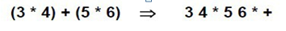
STACK OPERATIONS TO
EVALUATE ARITHMETIC EXPRESSION
6
4
5
5
30
3
3
12
12
12
12
42
3
4
*
5
6
*
+

Slide 39
BASIC COMPUTER ORGANIZATION
Computer Registers
Computer Instructions
Timing and Control
Instruction Cycle

Slide 40
NEED OF REGISTERS
Computer instructions are normally stored in consecutive memory locations and are executed sequentially one at a time.
The control reads an instruction from a specific address in memory and executes it. It then continues by reading the next instruction in sequence and executes it, and so on.
This type of instruction sequencing needs a counter to calculate the address of the next instruction after execution of the current instruction is completed.
It is also necessary to provide a register in the control unit for storing the instruction code after it is read from memory.
The computer needs processor registers for manipulating data and a register for holding a memory address.

Slide 41
THE BASIC COMPUTER
The Basic Computer has two components, a processor and memory
The memory unit has a capacity of 4096 words and each word contains 16 bits.
Twelve bits of an instruction word are needed to specify the address of an operand.
This leaves three bits for the operation part of the instruction and a bit to specify a direct or indirect address
– 4096 = 2¹², so it takes 12 bits to select a word in memory
Each word is 16 bits long
RAM
CPU
0
15
0
4095

Slide 42
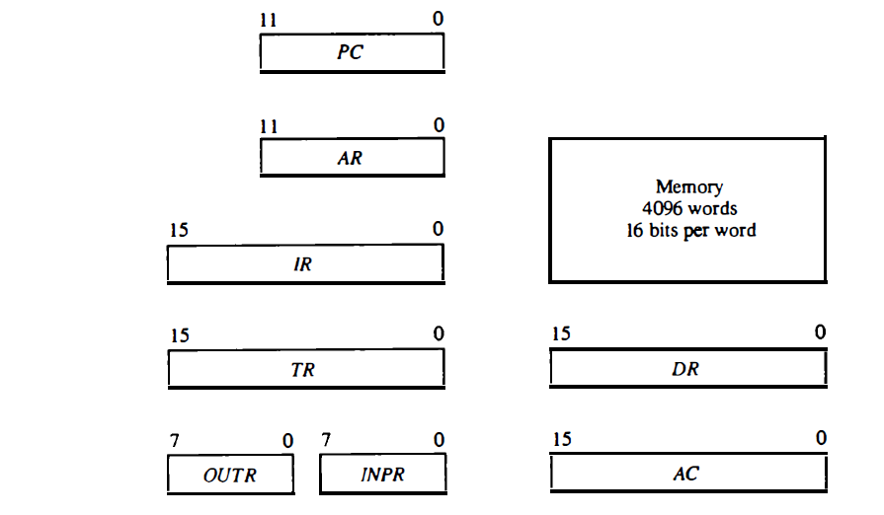
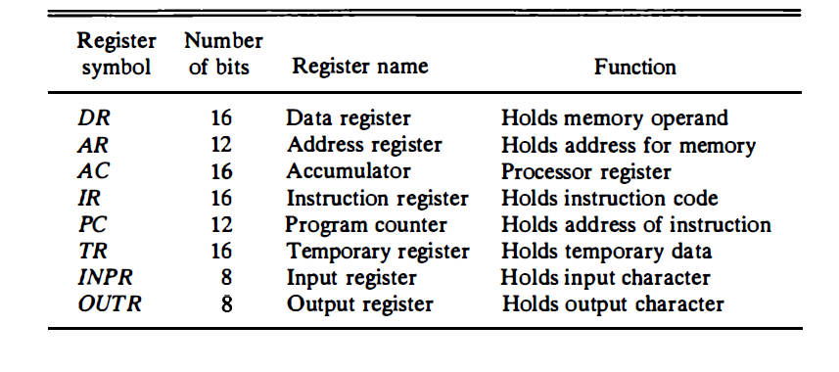
THE BASIC COMPUTER REGISTERS

Slide 43
PROCESSOR REGISTERS
A processor has many registers to hold instructions, addresses, data, etc
The processor has a register, the Program Counter (PC) that holds the memory address of the next instruction to be executed
Since the memory in the Basic Computer only has 4096 locations, the PC only needs 12 bits
In a direct or indirect addressing, the processor needs to keep track of what locations in memory it is addressing: The Address Register (AR) is used for this - The AR is a 12 bit register in the Basic Computer
When an operand is found, using either direct or indirect addressing, it is placed in the Data Register (DR). The processor then uses this value as data for its operation
The Basic Computer has a single general purpose register – the Accumulator (AC)

Slide 44
PROCESSOR REGISTERS Contd.
The significance of a general purpose register is that it can be referred to in instructions
e.g. load AC with the contents of a specific memory location; store the contents of AC into a specified memory location
Often a processor will need a scratch register to store intermediate results or other temporary data; in the Basic Computer this is the Temporary Register (TR)
The Basic Computer uses a very simple model of input/output (I/O) operations
Input devices are considered to send 8 bits of character data to the processor
The processor can send 8 bits of character data to output devices
The Input Register (INPR) holds an 8 bit character gotten from an input device
The Output Register (OUTR) holds an 8 bit character to be send to an output device

Slide 45
COMMON BUS SYSTEM
The basic computer has eight registers, a memory unit, and a control unit. Paths must be provided to transfer information from one register to another and between memory and registers.
The number of wires will be excessive if connections are made between the outputs of each register and the inputs of the other registers.
A more efficient scheme for transferring information in a system with many registers is to use a common bus.
The outputs of seven registers and memory are connected to the common bus.
The specific output that is selected for the bus lines at any given time is determined from the binary value of the selection variables S2, S1, and S0.
The number along each output shows the decimal equivalent of the required binary selection.

Slide 46

COMMON BUS SYSTEM Contd.
S2
S1 Bus S0
Memory unit
7
4096 x 16
Address
Write
Read
AR
1
Three control lines, S₂, S₁, and S₀ control which register the bus selects as its input
LD INR CLR
PC
2
LD INR CLR
DR
3
LD INR CLR
E
^{S}2 ^{S}1 ^{S}0 |  |  | Register
0 | 0 | 0 | x
0 | 0 | 1 | AR
0 | 1 | 0 | PC
0 | 1 | 1 | DR
1 | 0 | 0 | AC
1 | 0 | 1 | IR
1 | 1 | 0 | TR
1 | 1 | 1 | Memory
ALU
AC
4
LD INR CLR
INPR
IR
5
LD
TR
6
LD INR CLR
OUTR
Clock
LD
16-bit common bus

Slide 47
COMMON BUS SYSTEM Contd.
Either one of the registers will have its load signal activated, or the memory will have its read signal activated
– Will determine where the data from the bus gets loaded
Four registers, DR , AC, IR, and TR, have 16 bits each. Two registers, AR and PC, have 1 2 bits each since they hold a memory address.
When the contents of AR or PC are applied to the 16-bit common bus, the four most significant bits are set to O's. When AR or PC receive information from the bus, only the 12 least significant bits are transferred into the register.
The input register INPR and the output register OUTR have 8 bits each and communicate with the eight least significant bits in the bus.
INPR is connected to provide information to the bus but OUTR can only receive information from the bus.
This is because INPR receives a character from an input device which is then transferred to AC .
OUTR receives a character from AC and delivers it to an output device. There is no transfer from OUTR to any of the other registers.

Slide 48
COMMON BUS SYSTEM Contd.
The input data and output data of the memory are connected to the common bus, but the memory address is connected to AR
Therefore, AR must always be used to specify a memory address. By using a single register for the address, we eliminate the need for an address bus that would have been needed otherwise
The content of any register can be specified for the memory data input during a write operation. Similarly, any register can receive the data from memory after a read operation except AC
The 16 inputs of AC come from an adder and logic circuit. This circuit has three sets of inputs. One set of 16-bit inputs come from the outputs of AC .
They are used to implement register microoperations such as complement AC and shift AC . Another set of 16-bit inputs come from the data register DR .
The inputs from DR and AC are used for arithmetic and logic microoperations, such as add DR to AC or AND DR to AC .
The result of an addition is transferred to AC and the end carry-out of the addition is transferred to flip-flop E extended AC bit). A third set of 8-bit inputs come from the input register INPR

Slide 49
INSTRUCTIONS
Program
A sequence of (machine) instructions
(Machine) Instruction
A group of bits that tell the computer to perform a specific
operation (a sequence of micro-operation)
The instructions of a program, along with any needed data are stored in memory
The CPU reads the next instruction from memory, It is placed in an Instruction Register (IR)
Control circuitry in control unit then translates the instruction into the sequence of microoperations necessary to implement it

Slide 50
INSTRUCTION FORMAT
A computer instruction is often divided into two parts
An opcode (Operation Code) that specifies the operation for that instruction
An address that specifies the registers and/or locations in memory to use for that operation
In the Basic Computer, since the memory contains 4096 (= 2¹²) words, we needs 12 bit to specify which memory address this instruction will use
In the Basic Computer, bit 15 of the instruction specifies the addressing mode (0: direct addressing, 1: indirect addressing)
Since the memory words, and hence the instructions, are 16 bits long, that leaves 3 bits for the instruction’s opcode
15 14
12 11
0
Instruction Format
I | Opcode | Address
Addressing
mode

Slide 51
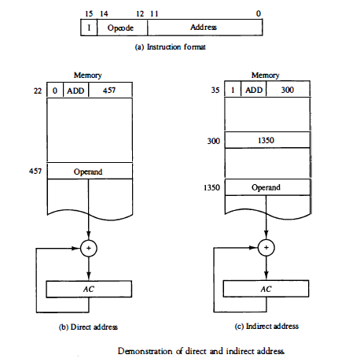
DIRECT AND INDIRECT ADDRESSING

Slide 52

BASIC COMPUTER INSTRUCTIONS
Basic Computer Instruction Format
I=0, Direct addressing mode
I=1, Indirect addressing mode
Memory-Reference Instructions
15 14 12 11
(OP-code = 000 ~ 110)
0
I | Opcode | Address
Register-Reference Instructions
(OP-code = 111, I = 0)
15 |  |  | 12 11 |  | 0
0 | 1 | 1 | 1 | Register operation
Input-Output Instructions
15 12 11
(OP-code =111, I = 1)
0
1 1 1 1
I/O operation

Slide 53
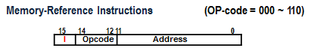
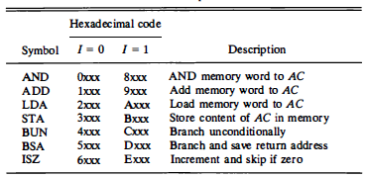
BASIC COMPUTER INSTRUCTIONS Contd.
I=0, Direct addressing mode
0 | 0 0 0 | - - - - - - - - - - - -
0 X X X
0 | 0 0 1 | - - - - - - - - - - - -
1 X X X
1
X
X
X
0 | 1 1 0 | - - - - - - - - - - - -
6 X X X
I=1, InDirect addressing mode
1 | 0 0 0 | - - - - - - - - - - - -
8 X X X
1 | 0 0 1 | - - - - - - - - - - - -
9 X X X
1 | 1 1 0 | - - - - - - - - - - - -
E X X X

Slide 54
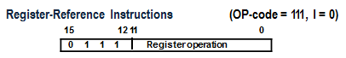
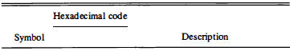
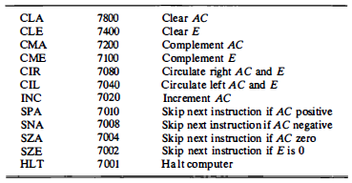
BASIC COMPUTER INSTRUCTIONS Contd.
7
0 | 1 1 1 | - - - - - - - - - - - -
7 X X X
7
X
X
X

Slide 55
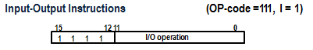
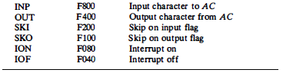
BASIC COMPUTER INSTRUCTIONS Contd.
F
1 | 1 1 1 | - - - - - - - - - - - -
F X X X
X
X
X
F

Slide 56

BASIC COMPUTER INSTRUCTIONS Contd.
Symbol | Hex Code | Description
 | I = 0 I = 1
AND ADD LDA STA BUN BSA ISZ | 0xxx 8xxx 1xxx 9xxx 2xxx Axxx 3xxx Bxxx 4xxx Cxxx 5xxx Dxxx 6xxx Exxx | AND memory word to AC Add memory word to AC Load AC from memory Store content of AC into memory Branch unconditionally Branch and save return address Increment and skip if zero
CLA | 7800 | Clear AC
CLE | 7400 | Clear E
CMA | 7200 | Complement AC
CME | 7100 | Complement E
CIR | 7080 | Circulate right AC and E
CIL | 7040 | Circulate left AC and E
INC | 7020 | Increment AC
SPA | 7010 | Skip next instr. if AC is positive
SNA | 7008 | Skip next instr. if AC is negative
SZA | 7004 | Skip next instr. if AC is zero
SZE | 7002 | Skip next instr. if E is zero
HLT | 7001 | Halt computer
INP | F800 | Input character to AC
OUT | F400 | Output character from AC
SKI | F200 | Skip on input flag
SKO | F100 | Skip on output flag
ION | F080 | Interrupt on
IOF | F040 | Interrupt off

Slide 57
FETCH , DECODE AND EXECUTE CYCLE VIDEO
https://www.youtube.com/watch?v=XM4lGflQFvA

Slide 58

INSTRUCTION CYCLE
In Basic Computer, a machine instruction is executed in the following cycle:
Fetch an instruction from memory
Decode the instruction
Read the effective address from memory if the instruction has an indirect address
Execute the instruction
After an instruction is executed, the cycle starts again at step 1, for the next instruction
Note: Every different processor has its own (different) instruction cycle

Slide 59
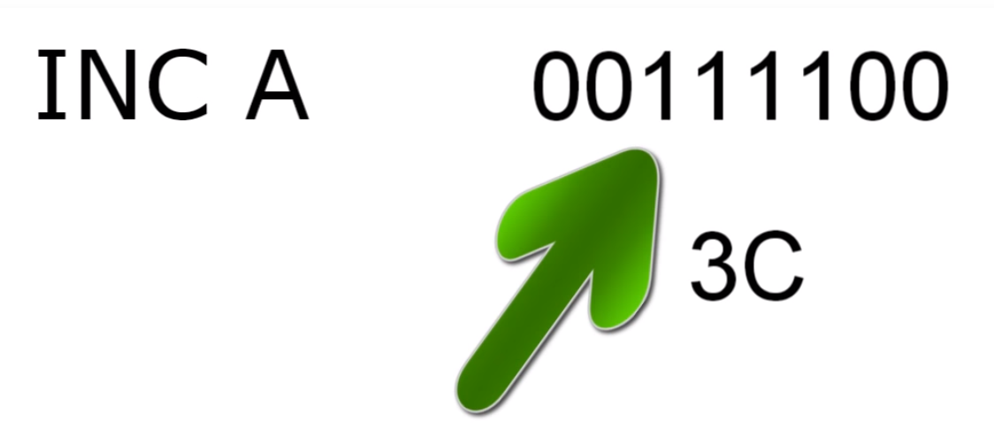
EXAMPLE INSTRUCTION

Slide 60
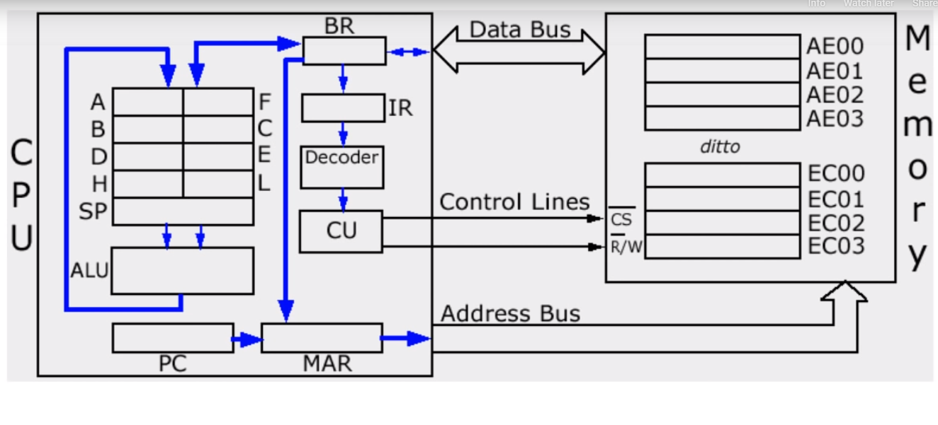
PROCESSOR ARCHITECTURE

Slide 61
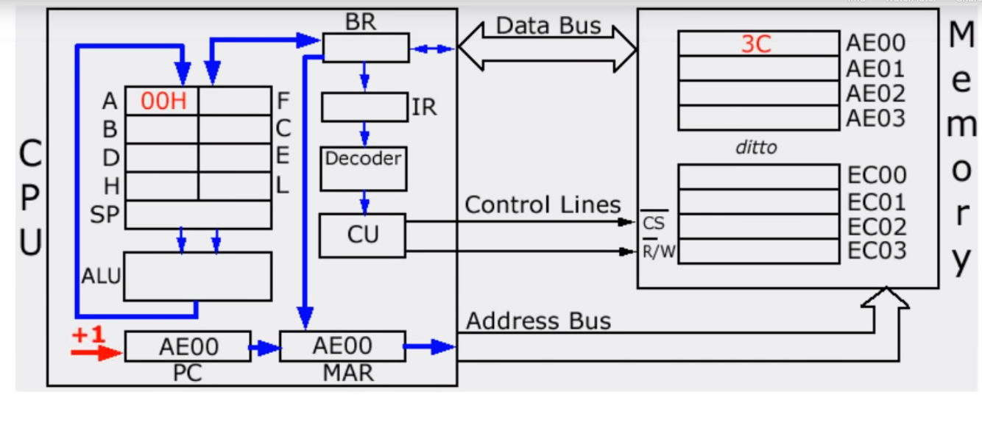
FETCHING AN INSTRUCTION

Slide 62
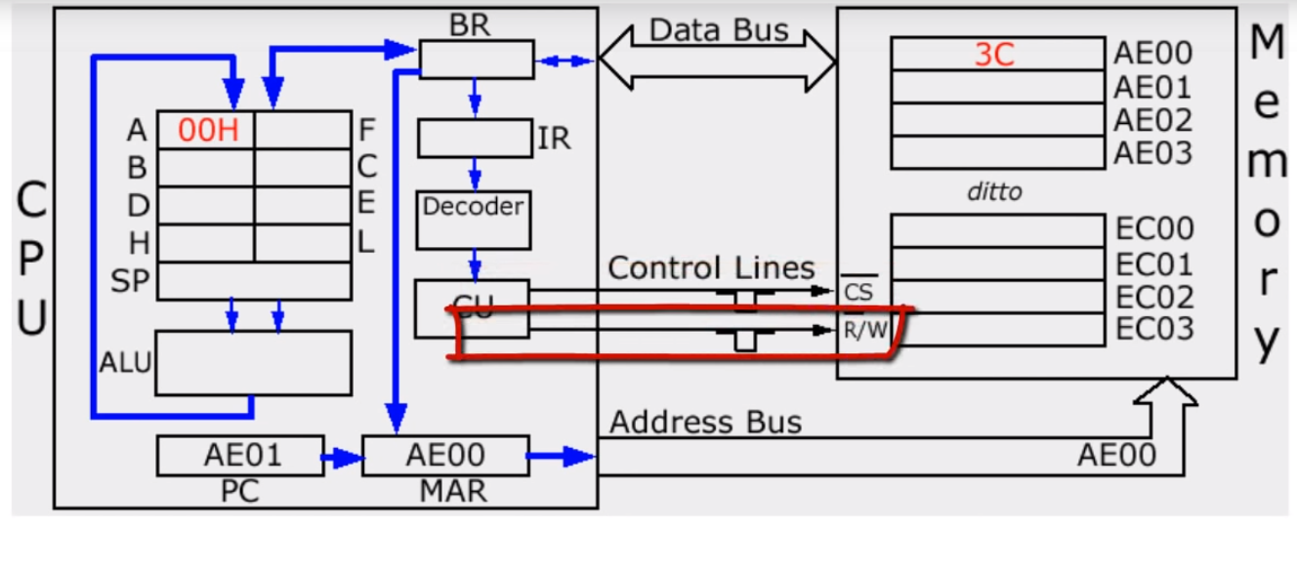
FETCHING AN INSTRUCTION Contd.

Slide 63
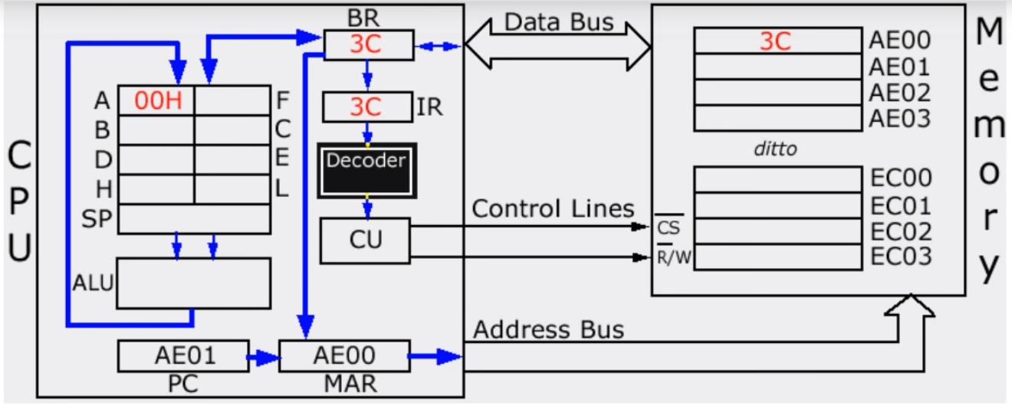
FETCHING AN INSTRUCTION Contd.

Slide 64
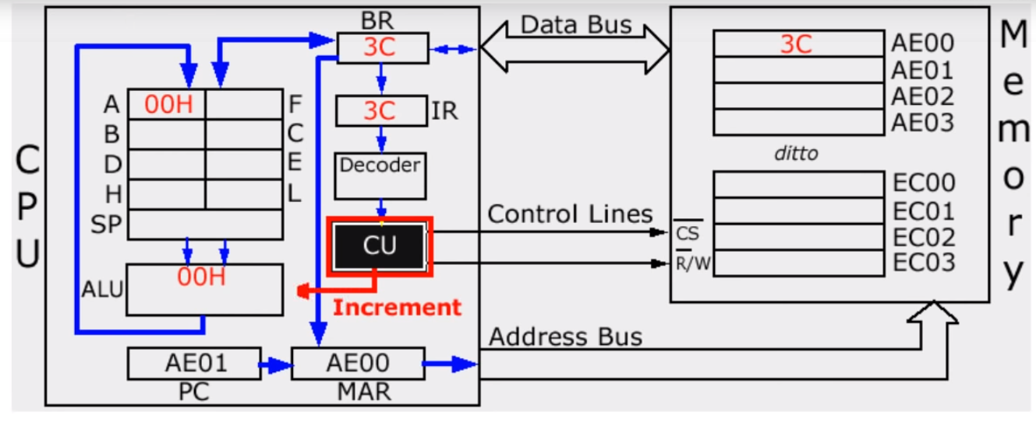
FETCHING AN INSTRUCTION Contd.

Slide 65
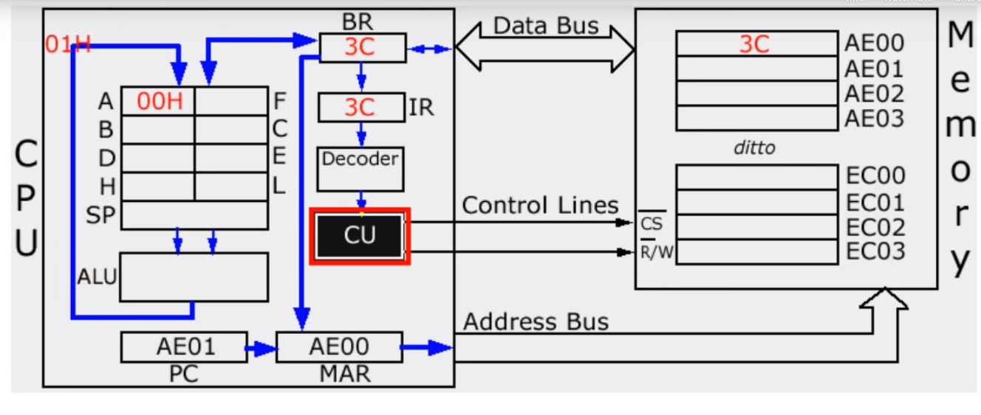
FETCHING AN INSTRUCTION Contd.

Slide 66
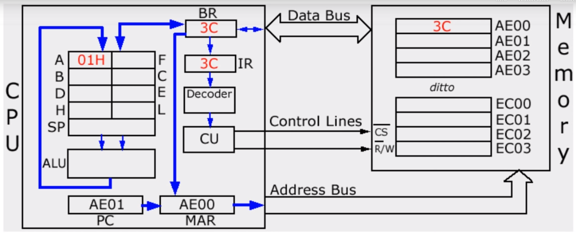
FETCHING AN INSTRUCTION Contd.

Slide 67


FETCH and DECODE
T0: AR ← PC (S₀S₁S₂=010, T0=1)
T1: IR ← M [AR], PC ← PC + 1 (S₀S₁S₂=111, T1=1)
T2: D0, . . . , D7 ← Decode IR(12-14), AR ← IR(0-11), I ← IR(15)
Fetch and Decode
0
1
0
T1
1
1
1
1
S₂ S₁ S₀
1
T0
Bus
0
Memory
7
111
IR
unit
Address
Read
AR
1
I ← IR(15)
LD
010
PC
2
D0, . . . , D7 ← Decode IR(12-14)
IR (14-12) | D7 D6 D5 D4 D3 D2 D1 D0
0 0 0 | 0 0 0 0 0 0 0 1
0 0 1 | 0 0 0 0 0 0 1 0
0 1 0 | 0 0 0 0 0 1 0 0
INR
IR
5
LD
Clock
Common bus
AR ← IR(0-11)

Slide 68
BASIC COMPUTER INSTRUCTIONS
Basic Computer Instruction Format
I=0, Direct addressing mode
I=1, Indirect addressing mode
Memory-Reference Instructions
15 14 12 11
(OP-code = 000 ~ 110)
0
I | Opcode | Address
Register-Reference Instructions
(OP-code = 111, I = 0)
15 |  |  | 12 11 |  | 0
0 | 1 | 1 | 1 | Register operation
Input-Output Instructions
15 12 11
(OP-code =111, I = 1)
0
1 1 1 1
I/O operation

Slide 69

DETERMINE THE TYPE OF INSTRUCTION
Start
SC ← 0
Flow chart for Instruction Cycle
AR ← PC
IR ← M[AR], PC ← PC + 1
IR (14-12) | D7 D6 D5 D4 D3 D2 D1 D0
0 0 0 | 0 0 0 0 0 0 0 1
0 0 1 | 0 0 0 0 0 0 1 0
1 1 1 | 1 0 0 0 0 0 0 0
T1
T2
Decode Opcode in IR(12-14),
AR ← IR(0-11), I ← IR(15)
(Register or I/O) = 1
= 0 (Memory-reference)
D7
(I/O) = 1
= 0 (register)
(indirect) = 1
= 0 (direct)
I
I
T3
T3
T3
T3
Execute input-output instruction
SC ← 0
Execute register-reference
instruction
SC ← 0
AR ← M[AR]
Nothing
Execute memory-reference
instruction
SC ← 0
T4
D'7IT3: D'7I'T3: D7I'T3: D7IT3:
AR  M[AR]
Nothing
Execute a register-reference instr.
Execute an input-output instr.

Slide 70
MICROOPERATIONS
Microoperations are classified into four categories:
– Register transfer microoperations (data moves from register
to register)
– Arithmetic microoperations (perform arithmetic on data in
registers)
– Logic microoperations (perform bit manipulation on data in
registers)
– Shift microoperations (perform shift on data in registers)

Slide 71
ARITHMETIC MICROOPERATIONS
Unlike register transfer microoperations, arithmetic microoperations change the information content.
The basic arithmetic microoperations are:
– addition
– subtraction
– increment
– decrement
Multiplication and division are not considered microoperations.
– Multiplication is implemented by a sequence of adds and shifts.
– Division is implemented by a sequence of subtracts and shifts.

Slide 72

ARITHMETIC MICROOPERATIONS Contd.

Slide 73
BINARY ADDER
To implement the add microoperation with hardware we need the registers to hold the data and a digital circuit to perform the addition (called a binary adder)
The binary adders is constructed using full adders connected in cascade so that the carry produced by one full adder becomes an input for the next
Adding two n-bit numbers requires n full adders
The n data bits for A and B might come from R1 and R2 respectively

Slide 74

BINARY ADDER Contd.
A= A₃ A₂ A₁ A₀
To add two 4 bit numbers A and B, four full adders are required
B = B₃ B₂ B₁ B₀
S = S₃ S₂ S₁ S₀
Truth table of Full Adder
A | B | Sum S | Carry C
0 | 0 | 0 | 0
0 | 1 | 1 | 0
1 | 0 | 1 | 0
1 | 1 | 0 | 1
A
B
Full Adder (FA)
Sum (S)
Carry (C )

Slide 75

ADDER-SUBTRACTOR

Slide 76

ADDER-SUBTRACTOR Contd.
0
1
1
=1
0
1
1
1
0
M= 0 , Indicates addition
M= 1 , Indicates Subtraction
A-B→A+B’+1
In an ExOR gate, if any one of the inputs is 0, Output = Input
If one of the inputs is 1, Output = Input’
A= A₃ A₂ A₁ A₀
B = B’₃ B’₂ B’₁ B’₀
1
S = S₃ S₂ S₁ S₀

Slide 77


BINARY INCREMENTER

Slide 78

ARITHMETIC CIRCUIT

Slide 79

4 BIT ARITHMETIC CIRCUIT
0 0 0
A₀
0
0
A₀+B₀+0 =A₀+B₀
B₀
0
B₀
A₁+B₁
0
0
A₂+B₂
0
0
A₃+B₃
0
0
D= A + B (Add micro operation)

Slide 80

ARITHMETIC CIRCUIT FUNCTION TABLE

Slide 81

LOGICAL MICROOPERATIONS

Slide 82


TRUTH TABLE FOR 16 2-VARIABLE FUNCTION

Slide 83

SIXTEEN LOGICAL MICROOPERATIONS

Slide 84

SIXTEEN LOGICAL MICROOPERATIONS Contd.

Slide 85

ONE STAGE OF A LOGIC CIRCUIT

Slide 86

SHIFT MICROOPERATIONS

Slide 87

SHIFT MICROOPERATIONS Contd.

Slide 88

Arithmetic Shift Right
ARITHMETIC SHIFT RIGHT
Arithmetic Shift Right, leaves sign bit unchanged
Sign bit is 0 for positive and 1 for negative
n-2

Slide 89


4-BIT COMBINATIONAL CIRCUIT SHIFTER

Slide 90

ARITHMETIC LOGIC SHIFT UNIT

Slide 91


Slide 92


FUNCTIONAL TABLE FOR ARITHMETIC LOGICAL SHIFT UNIT

